Slide 1

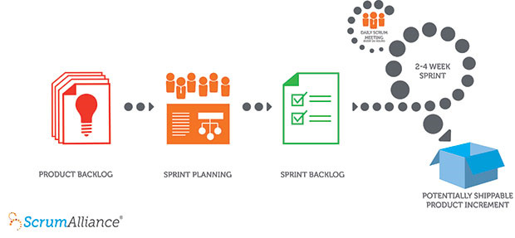
The X-Copter Project: Project Management
University of
Applied Sciences
Project Management
Scrum:

Slide 2
The X-Copter Project: Project Management
University of
Applied Sciences
Change Project Management
Scrum:
Positive | Negative
Daily Scrum | Sprint Planning
Taskboard | Sprint Review
 | Sprint Retrospektive
Result: Scrum only works if the team meets every day

Slide 3
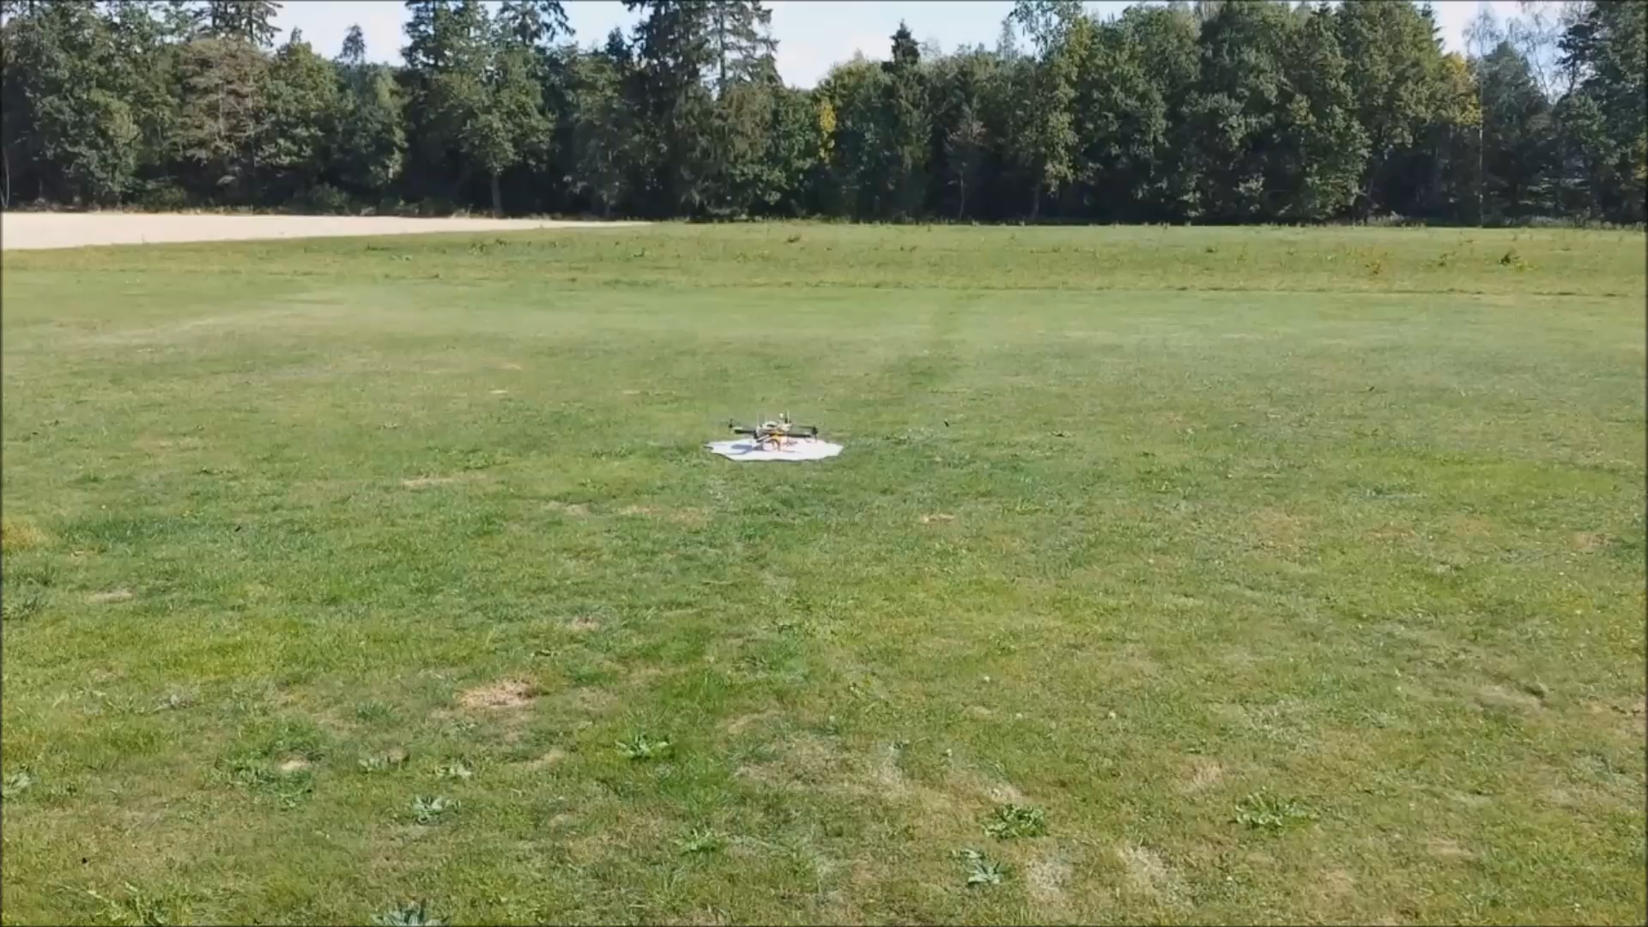
The X-Copter Project: First flight
University of
Applied Sciences
Flight test of the model:

